Slide 1
AGE-STRUCTURED SIR MODEL
Name: Sharon Zhou Student ID:33116040
Notes:
Hi my name is Sharon Zhou and the base model I have chosen was the continuous SIR model.

Slide 2
WHAT IS THE S.I.R. MODEL?
Purpose: to understand the spread of disease within the population
Everyone falls under 3 compartment:
Susceptible
Infected
Recovered
Notes:
The continuous SIR model is a model that was proposed by Kermack and McKendrick in 1927, which tries to understand the spread of infectious diseases within the population.
The model assumes that everyone falls within one of three comparments:
Susceptible- people who are vulnerable to the infection
Infected- People who have already become infected
And Recovered- People who are now immune to the infection.

Slide 3
SIR KEY ASSUMPTIONS
Population is held constant
Population is assumed to be homogenous
No latent or exposed infection period
Recovered individuals are fully immune
Transmission and recovery rates remain constant
Notes:
Furthermore there are a few other key assumptions to this model.
The number of individuals within this model will be held constant, not accounting for deaths and births.
The population is assumed to be homogenous- that is they all have the same contact rate and transmission rate
There is no latent or exposed period in which individuals are exposed but not yet infected
Individuals who are recovered are fully immune and may not become infected or susceptible again.
Transmission and recover rates remain constant

Slide 4
MY MODEL: An age structure SIR MODEL
1. How does the presence of age-structure within the population affect the spread of disease?
In the case in which age structure affects the spread of disease, what is the most optimal vaccination campaign, when considering budget, and differentiating vaccination costs for each age group?
Notes:
This report aims to target the second assumption, that population is assumed to be homogenous. This means that all individuals, regardless of race, age, gender or any other types of groupings, will have the same rate of infection and recovery. However, within the real world context, this is not true as each group has differing social patterns and habits, as well as different immunities. For example, children, adult and elderly all have different susceptibilities as adults may constantly have to go into office every day to work, but elderly may have to stay home often.
My report aims to explore this dynamic of having heterogenous groups, specifically, age structure, within the SIR model.
Hence, the report in which I have created aims to target these questions:
How does the presence of age-structure within the population affect the spread of disease?
In the case in which age structure affects the spread of disease, what is the most optimal vaccination campaign, when considering budget, and differentiating vaccination costs for each age group? i.e. Are mass vaccination campaigns better, or targeted vaccination campaigns

Slide 5
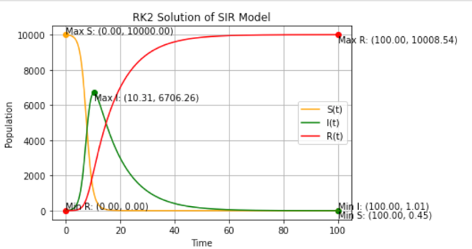

ORIGINAL SIR MODEL
$\frac{dS}{dt}= −βSI$
$\frac{dI}{dt}= βSI− λI$
$\frac{dR}{dt}= λI$
Notes:
But before we take a look at these questions, let’s look at the ODE equations of the original SIR model.
Within this case, dS/dt, dI/dt and dR/dt refer to the rates of change of the susceptible, infected and recovered population over time, the beta represents the rate of infection and gamma represents the rate of recovery. The term SI indicates that there is an interaction between infected and susceptible individuals.
The graph within this page shows the dynamics of the SIR infection with individuals moving from susceptible to infected and eventually, all of them will become recovered.

Slide 6
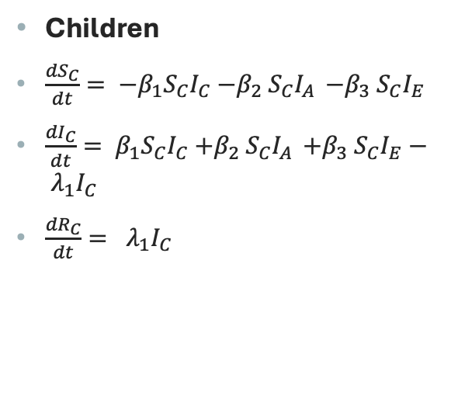

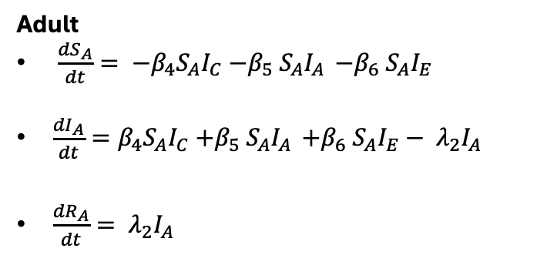
MY MODEL EXTENSION
Elderly
$\frac{{dS}_{E}}{dt}= {−β}_{7}S_{E}I_{C}{−β}_{8}S_{E}I_{A }{−β}_{9}S_{E}I_{E}$
$\frac{{dI}_{E}}{dt}=β_{7}S_{E}I_{C}{+β}_{8}S_{E}I_{A }{+β}_{9}S_{E}I_{E}− λ_{3}I_{E}$
$\frac{{dR}_{E}}{dt}= λ_{3}I_{E}$
Children
$\frac{{dS}_{C}}{dt}= {−β}_{1}S_{C}I_{C}{−β}_{2}S_{C}I_{A }{−β}_{3}S_{C}I_{E}$
$\frac{{dI}_{C}}{dt}= β_{1}S_{C}I_{C}{+β}_{2}S_{C}I_{A }{+β}_{3}S_{C}I_{E}− λ_{1}I_{C}$
$\frac{{dR}_{C}}{dt}= λ_{1}I_{C}$
Adult
$\frac{{dS}_{A}}{dt}= {−β}_{4}S_{A}I_{C}{−β}_{5}S_{A}I_{A }{−β}_{6}S_{A}I_{E}$
$\frac{{dI}_{A}}{dt}=β_{4}S_{A}I_{C}{+β}_{5}S_{A}I_{A }{+β}_{6}S_{A}I_{E}− λ_{2}I_{A}$
$\frac{{dR}_{A}}{dt}= λ_{2}I_{A}$
Notes:
Now, let us take a look at our extension.
As you can see our extension takes into account three separate age groups. Children, adults and elderly, creating S, I and R compartment for each age group. Our extension further models the interactions between different age groups, as seen by variables such as ScIa and ScIe, which means that susceptible children are interacting with infected adults and infected elderly individuals.

Slide 7
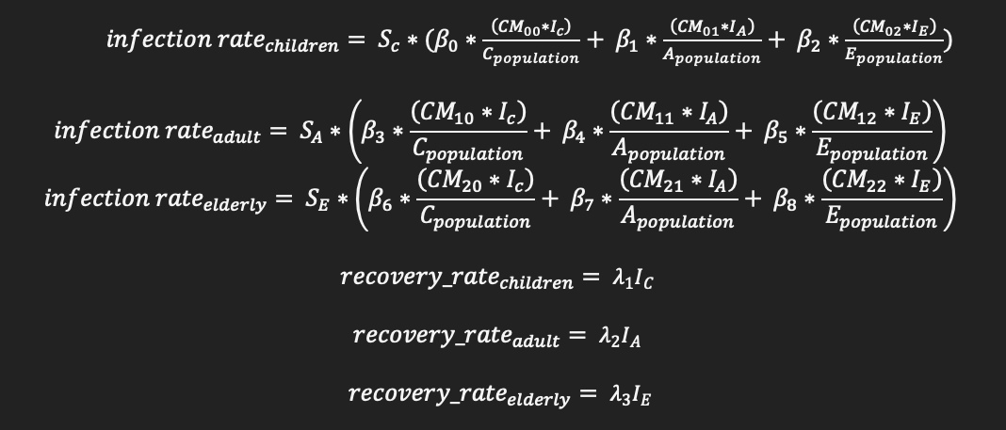
QUESTION 1: What is the effects of age structure on the spread of disease within the population?
Following propensities used:
Notes:
Now let’s take a look at the first question in which we are answering:
What is the effects of age-structure on the spread of disease within the population?
In order to answer this question, the Gillespie algorithm was employed, utilising the following propensities. CM contains the number of individuals which come in contact.
Note that within this case, the equations have been normalised in order to scale the average contacts. Without normalisation, these contacts will not scale properly with population size, leading to inaccurate infection rates.
Furthermore, the Gillespie algorithm utilises the Monte Carlo method is to predict the next event that occurs as well as the timing in which it occurs.

Slide 8
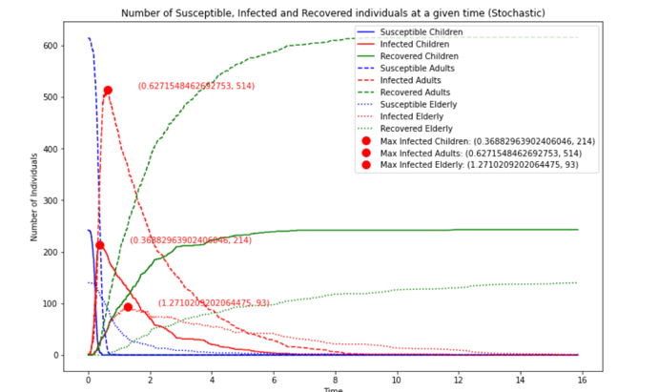
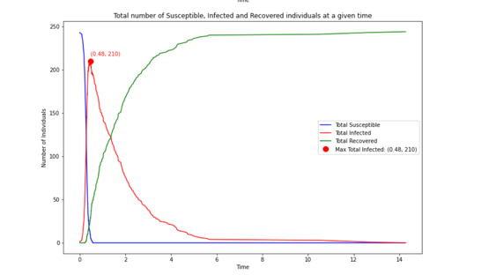
Question 1.
Table 1: Splits population into children, adults and elderly
Table 2: Homogenous population of 243 children
Notes:
Now to answer the question, lets take a look at the following graphs.
Within this case, figure 1 showcases the dynamics of the SIR model, splitting the graphs according to their respective age groups. Within this model, 243 children are present.
Figure 2 , represents the SIR dynamics of a homogenous population of 243 children. It can be seen that the line within table 1 appears to have more fluctuations. This is due to the idea that the inconsistent interaction rates may lead contact patterns to become more variable, which in turn results in a higher variability of infection numbers. Table 6 seems to take on a more smoother line as the entire population has the same statistics. This leads to the spread of infection to become more evenly distributed. Hence, the higher variability of infection within Table 1, may indicate that having a variety of age groups within a population may lead to more sudden outbreaks within the disease.

Slide 9
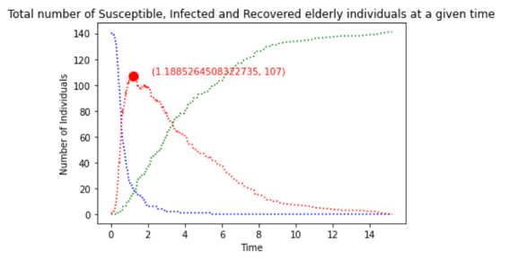
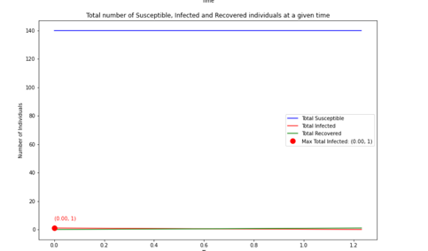
Question 1
Figure 3: Homogenous population of 140 elderly, who come in contact with one other elderly person, as well as adults and children
Figure 4: Homogenous population of 140 elderly, who come in contact with one other elderly person
Notes:
Furthermore, incorporating age structure may increase or slow down the rates of infection within a given age group. Let us now take a look at Table 3 and table 4. Table 3 tells us about the disease dynamics amongst 140 elderly individuals who come in contact with adults, children and other elderly people. Table 4 tells us about a homogenous population of 140 elderly people who come in contact only other elderly people. Within these cases, it is assumed that they only come in contact with one other elderly person at each given time.
As we can observe from table 4, all individuals seem to stay within the same compartment. However, within table 3, individuals move from susceptible to infectious and then to recovered. This indicates that interactions amongst differing age groups has induced a quicker spread of disease amongst the elderly population. Note that as homogenous, the situation represented within table 4 is unrealistic as elderly individuals within the real world interact with people from other age groups. Hence, table 3 is a more realistic representation of the spread of disease amongst the elderly population, highlighting the importance of conducting an age-structured simulation to estimate the real life dynamics of a disease.

Slide 10
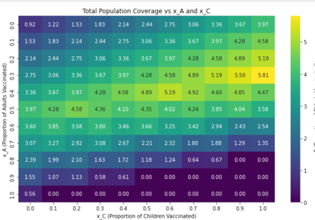
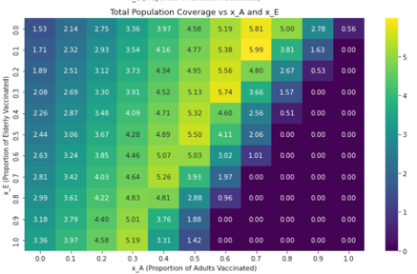
Question 2: heat maps
Table 1: Child vs Adult
Table 2: Child vs Elderly
Table 3: Adult vs Elderly
Notes:
In the case in which age structure affects the spread of disease, what is the most optimal vaccination campaign, when considering budget, and differentiating vaccination costs for each age group? i.e. Are mass vaccination campaigns better, or targeted vaccination campaigns
This question incorporates the use of heuristics in order to calculate the combination of proportions of each age group vaccinated, to obtain the optimal vaccine coverage within a given budget. For mass vaccinations, the same proportion of each group are vaccinated. However, for targeted vaccinations, this is not the case. So what does the targeted vaccination prioritise?
To answer this question, 3 heat maps were created. Table 1 models the relationship between the proportion of children who should be vaccinated and the proportion of adults who should be vaccinated in order to gain maximal vaccine coverage.
Table two does the same for children and elderly.
And table three does this for elderly and adults.
From table 1 and 2, it can be seen from the positions of the yellow cells that child vaccination is prioritised over adults and elderly. Furthermore, from table 3, adult vaccination is prioritised over elderly vaccination.

Slide 11
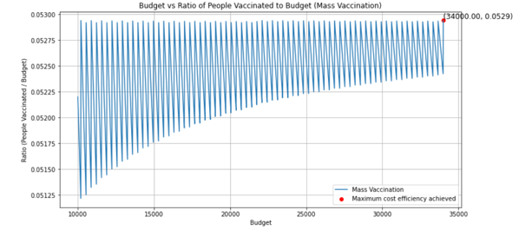
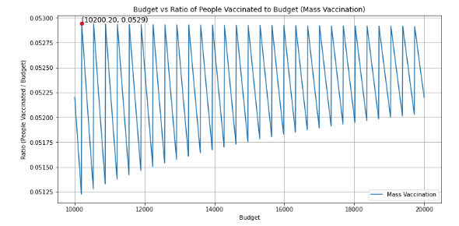
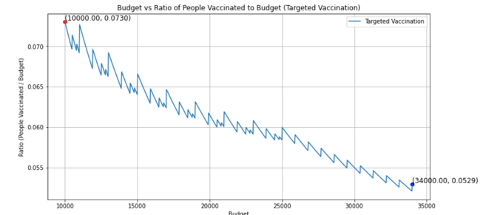
Question 2: cost efficiency analysis
Figure 1: Cost efficiency analysis of mass vaccination strategy- Budget range $10000-$34000
Figure 2: Cost efficiency analysis of mass vaccination strategy- Budget range $10000-$20000
Figure 3: Cost efficiency analysis of targeted vaccination strategy- Budget range $10000 - $34000
Notes:
Now, moving on to the actual question, a cost efficiency analysis may be conducted.
These first two graphs represent the cost efficiency analysis of mass vaccinations. Within this case, it can be seen that the maximum cost efficiency caps at 0.0529 people vaccinated per dollar spent on the vaccination campaign.
Now looking at figure 3, we can see that the maximum cost efficiency is 0.0729 people vaccinated per dollar spent on the vaccination campaign. Hence, it can be inferred that the targeted vaccination campaign may be more effective in terms of coverage, as it is more cost efficient. That is, a lower amount of money can be spent on vaccinating more people.

Slide 12
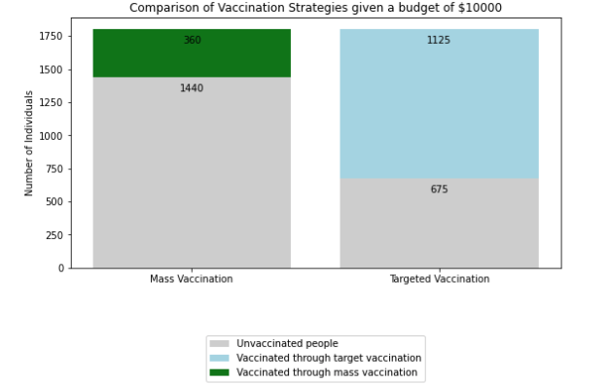
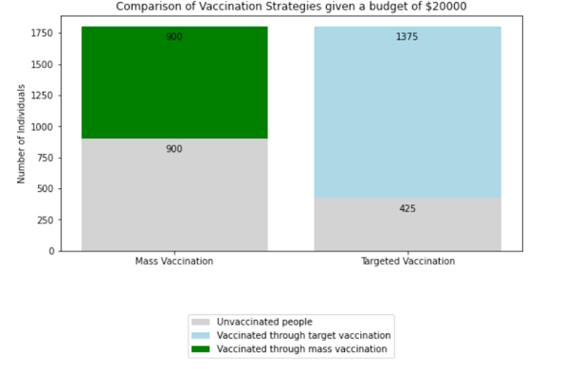
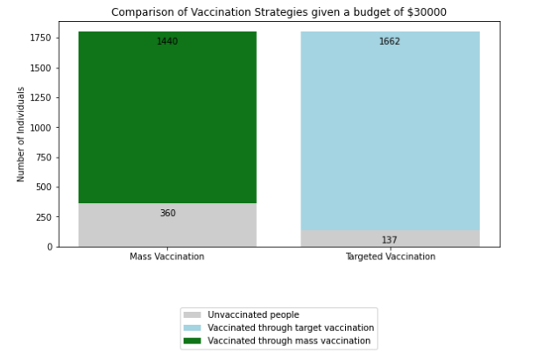
Question 2: bar graphs
Notes:
This idea is further solidified by these presented bar graphs containing the actual number of individuals vaccinated per given budget. Within this case, it can be seen that regardless of budget, the targeted vaccination campaign contains a higher vaccination coverage.
Hence, after completing an analysis of the cost efficiency, as well as total vaccination coverage, it can be concluded that when accounting for age structure, a targeted vaccination campaign is most efficient when considering costs of vaccination and total budget are considered as well.

